Slide 1
Text mining application in JAVA to detect a word and character stream from a document
GROUP MEMBERS
DIPANGSHU MANDAL
SOURAV KUMAR DAS
MONIS AHMED RIZVI
OM GAVALI
SUBHAM MOHANTY

Slide 2
Problem Statement
The Program will take a text file as input
User has to give any input for matching the input with the text file
It should give output as the string is present or not in the text file

Slide 3
System Requirements
JDK 1.8
Windows 10,Windows 8.x,Windows 7 SP1,Windows Server 2008 R2 SP1
Disk Space:124 MB

Slide 4
Functional Requirements
System need to be able to take input from the user
System should be able to take any document as input for analysis
System should be able to process any kind of document file
System should send a clear output message to the user

Slide 5
Non Functional Requirements
Code should be optimized enough to run on any hardware
The user should get the output as soon as possible after execution
The application should take minimal space
The application should be user-friendly

Slide 6
Test Cases
Sl. No. | Input |  | Actual Output | Expected Output | Status
1 | acne | Word.txt | Word found | Word found | pass
2 | acne | Sentence.txt | Word not found | Word not found | pass
3 | Break the block | Sentence.txt | Word found | Word found | pass
4 | Break the block | Word.txt | Word not found | Word not found | pass

Slide 7
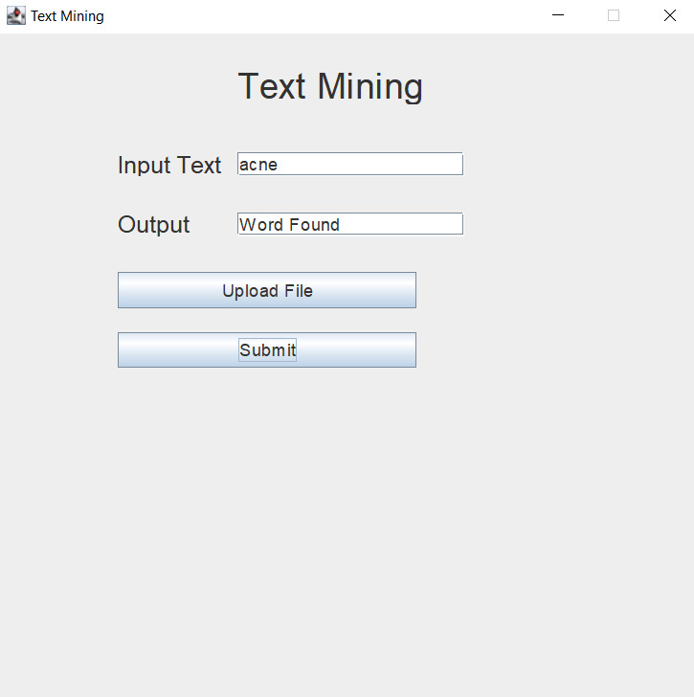
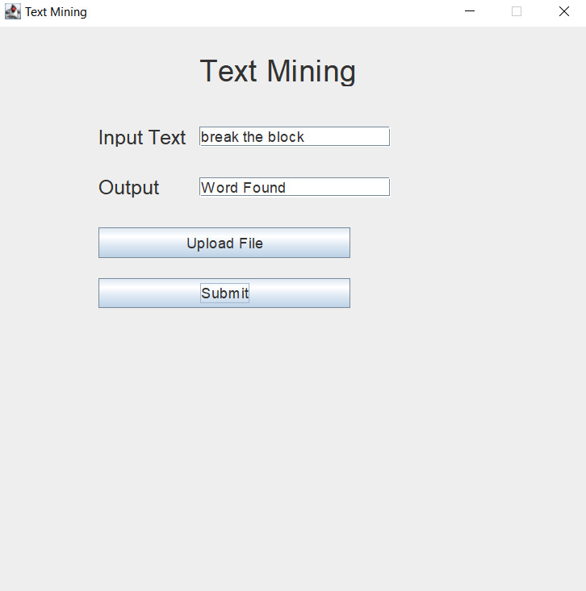
Snapshots

